Slide 1
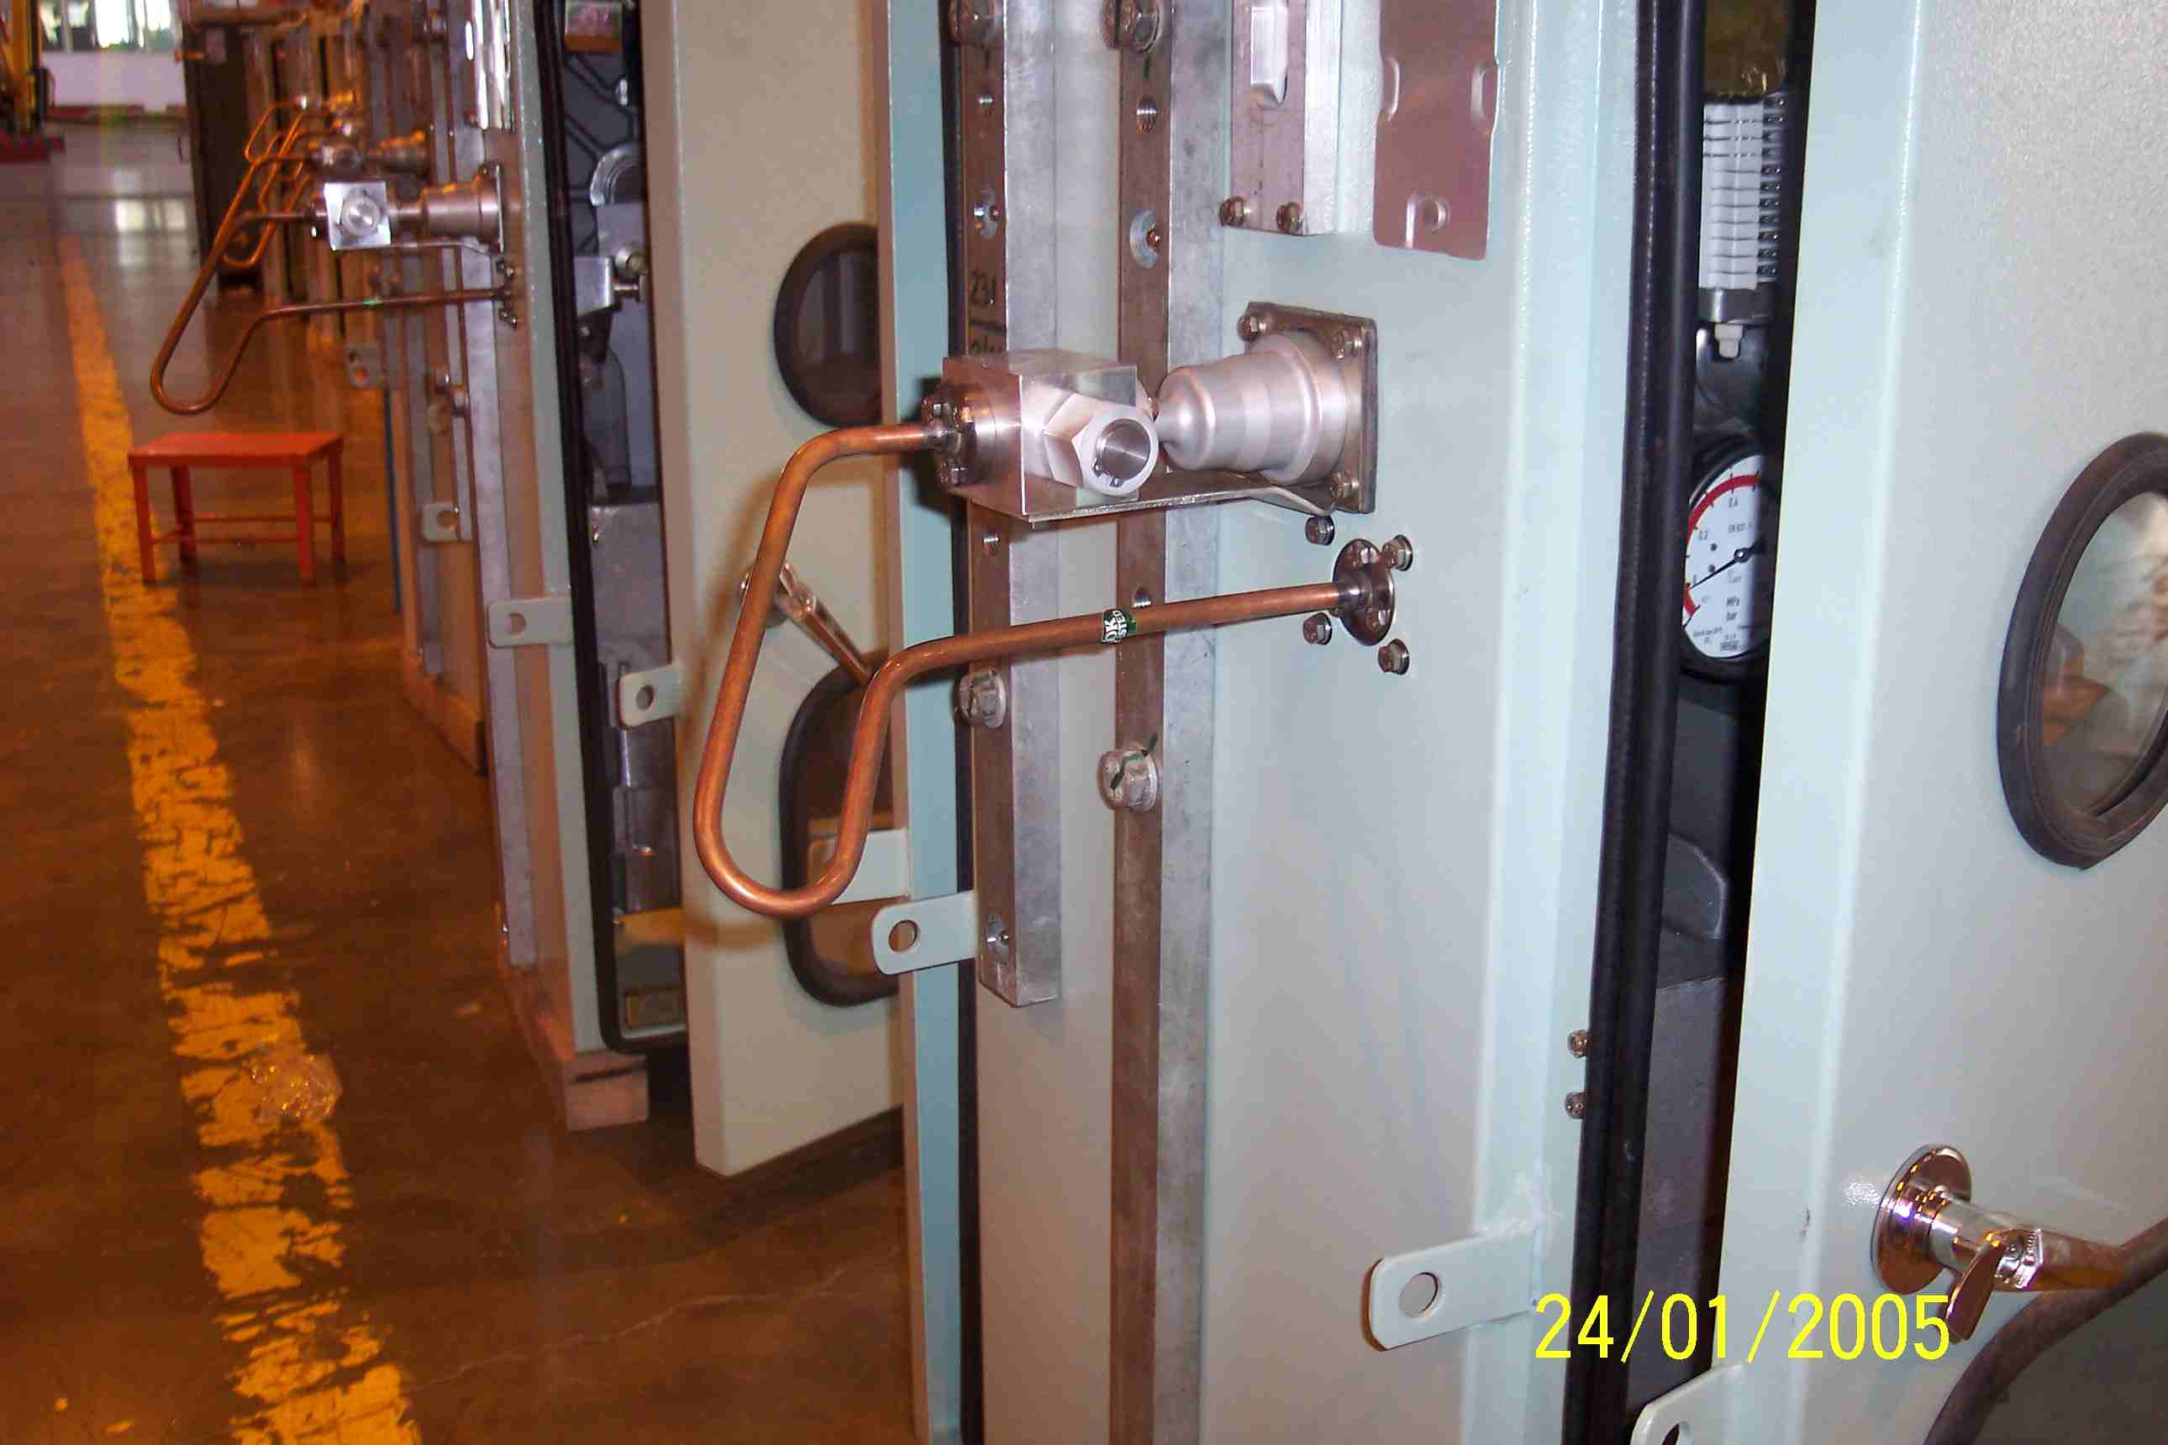
SIEMENS
HVCB SPARES
Small Gas pipe-1, 245KV, 50KA CB
S4805014002

